Slide 1



Capstone Project-I
EDA on Hotel Booking Analysis by Ashveen Kumar Verma (Self)

Slide 2

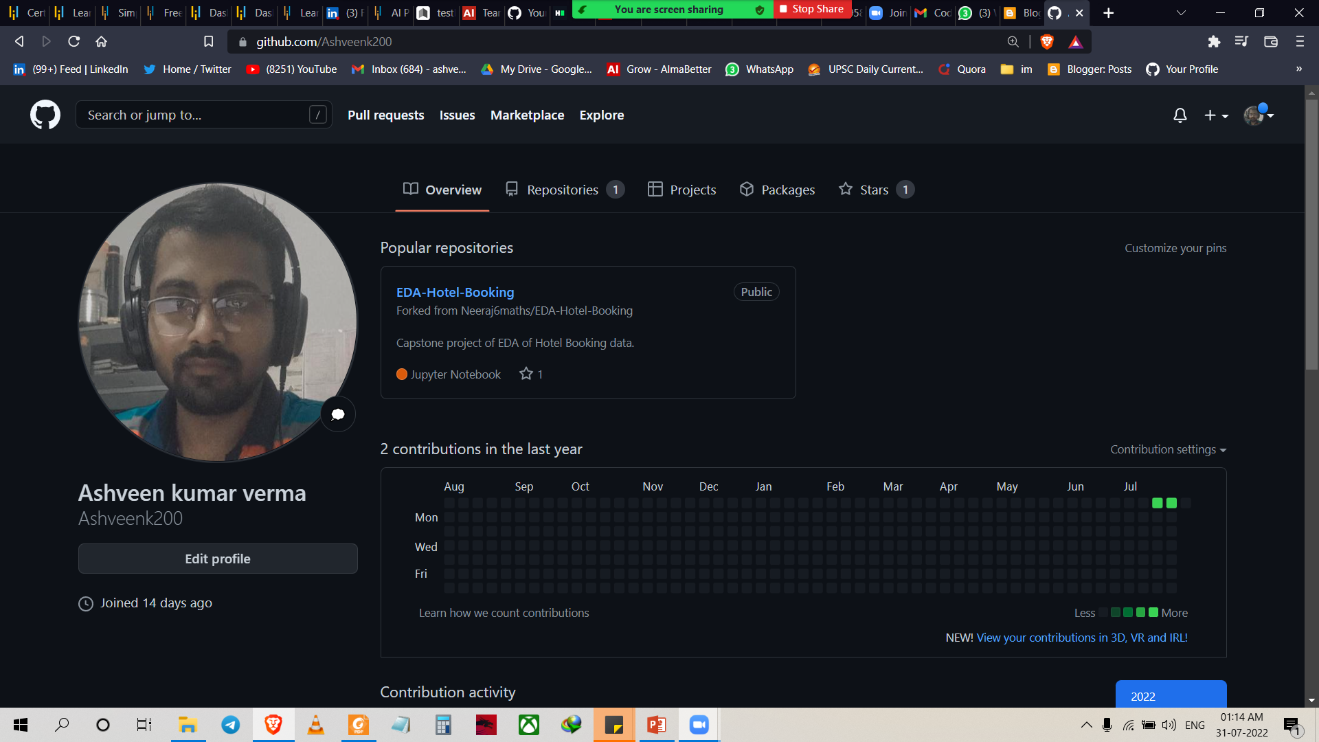
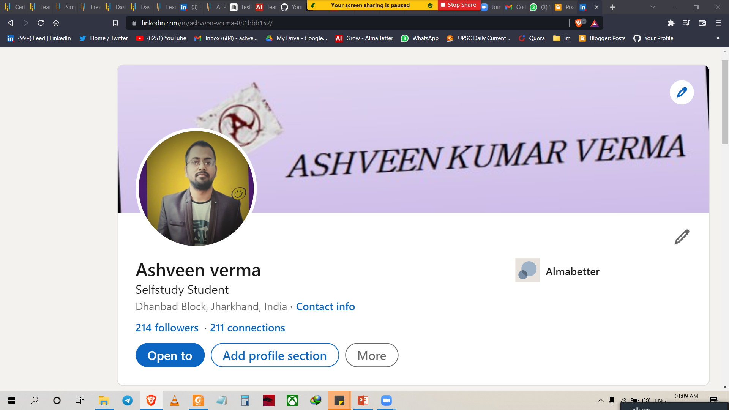
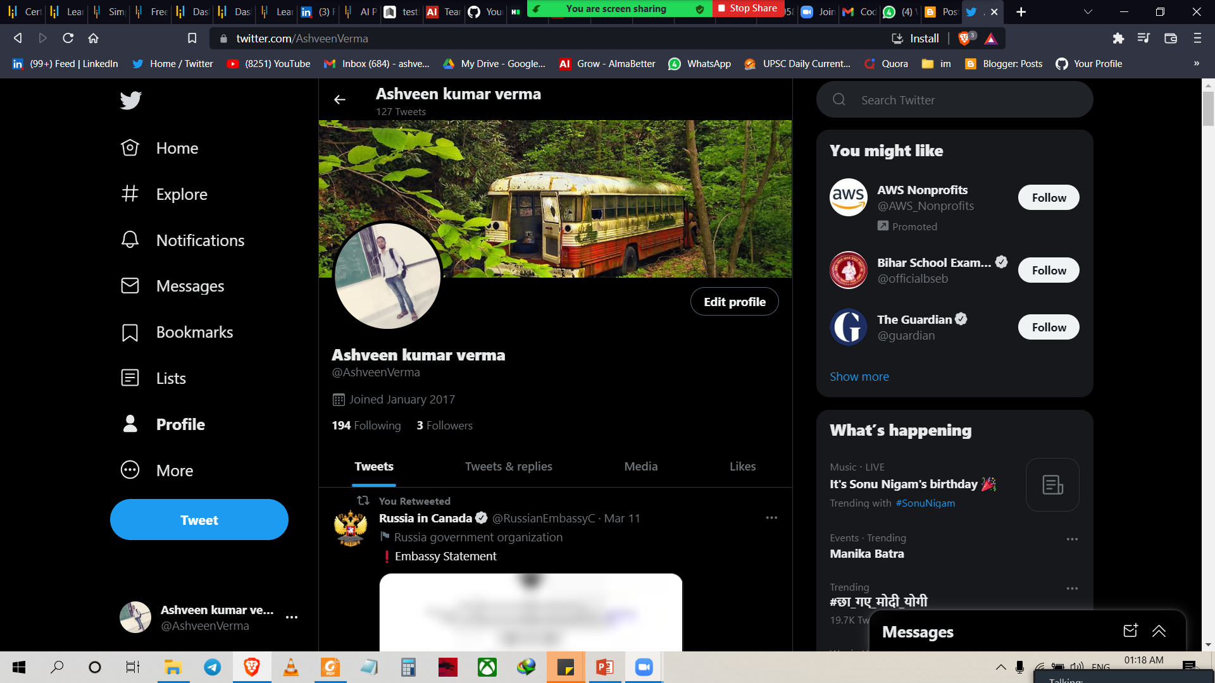


ASHVEEN KUMAR VERMA
Live in Dhanbad Jharkhand
Bsc graduate from pk roy memorial collage Dhanbad in 2020.
Enrolled in DS program.
This is my 1st capstone project
Linkedin- Ashveen verma
Github- Ashveen kumar verma
Twitter- Ashveen kumar verma
Wow finally got 80% discount in hotel booking

Slide 3
Problem Statement
1. For this project we will analysing Hotel Booking data. This data set contains booking iformation for a city hotel and a resort hotel, and includes information such as when the booking was made , length of stay , the number of adults , children , or babies, and the number of available parking spaces.
Hotel industry is a very volatile industry and the bookings depends on above factors and many more.
The main objective behind this project is to explore and analyse data to discover important factor that govern the bookings and give insights to hotel management , which can perform various campaigns to boost the business and performance.

Slide 4
Work Flow:-
So we divide our work flow into following 3 steps.
EDA will be divided into 3 following 3 analysis.
Univariate analysis:- It is the Simplest of the three analyses where the data you are analysing is only one variable
Bivariate analysis:- It is where you are comparing two varieable to study their relationship.
Multivariate Analysis :- It is similar to Bivariate analysis but you are comparing more than two variables.
Data collection and
Understanding
Data cleaning and manipulation
Exploratory Data Analysis(EDA)

Slide 5
After collecting data it’s important to understand your data . So we had Hotel Booking analysis data which had 119390 rows and 32 columns. So lets understand this 32 columns.
Data Description:-
hotel : Hotel(Resort Hotel or City Hotel)
is_canceled : Value indicating if the booking was canceled (1) or not (0)
lead_time : Number of days that elapsed between the entering date of the booking into the PMS and the arrival date
arrival_date_year : Year of arrival date
arrival_date_month : Month of arrival date
arrival_date_week_number : Week number of year for arrival date
arrival_date_day_of_month : Day of arrival date
stays_in_weekend_nights : Number of weekend nights (Saturday or Sunday) the guest stayed or booked to stay at the hotel
stays_in_week_nights : Number of week nights (Monday to Friday) the guest stayed or booked to stay at the hotel.

Slide 6
adults : Number of adults children : Number of children babies : Number of babies meal : Type of meal booked. Categories are presented in standard hospitality meal packages: country : Country of origin market_segment : Market segment designation. In categories, the term “TA” means “Travel Agents” and “TO” means “Tour Operators” distribution_channel : Booking distribution channel. The term “TA” means “Travel Agents” and “TO” means “Tour Operators” is_repeated_guest : Value indicating if the booking name was from a repeated guest (1) or not (0) previous_cancellations : Number of previous bookings that were cancelled by the customer prior to the current booking.

Slide 7
booking_changes : Number of changes/amendments made to the booking from the moment the booking was entered on the PMS until the moment of check-in or cancellation deposit_type : Indication on if the customer made a deposit to guarantee the booking. agent : ID of the travel agency that made the booking company : ID of the company/entity that made the booking or responsible for paying the booking. days_in_waiting_list : Number of days the booking was in the waiting list before it was confirmed to the customer customer_type : Type of booking, assuming one of four categories adr : Average Daily Rate as defined by dividing the sum of all lodging transactions by the total number of staying nights required_car_parking_spaces : Number of car parking spaces required by the customer previous_bookings_not_canceled : Number of previous bookings not cancelled by the customer prior to the current booking reserved_room_type : Code of room type reserved. Code is presented instead of designation for anonymity reasons. assigned_room_type : Code for the type of room assigned to the booking. required_car_parking_spaces : Number of car parking spaces required by the customer total_of_special_requests : Number of special requests made by the customer

Slide 8
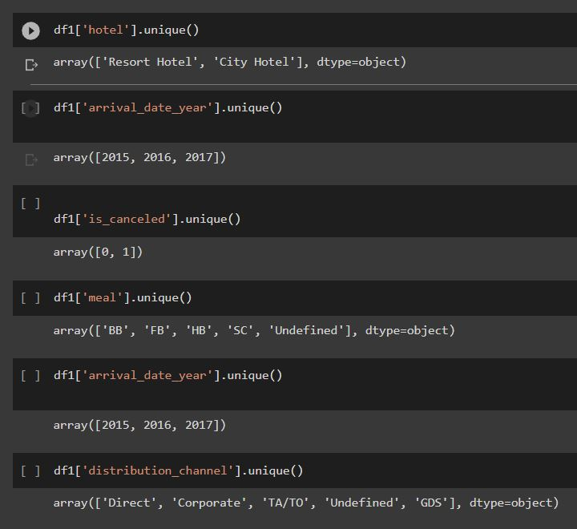
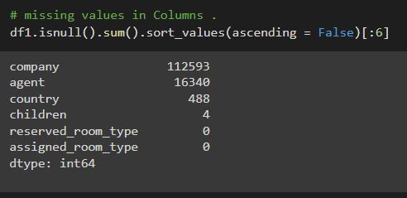
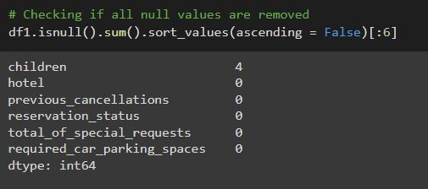
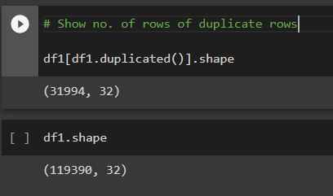
Data cleaning and Manupulation :-

Slide 9
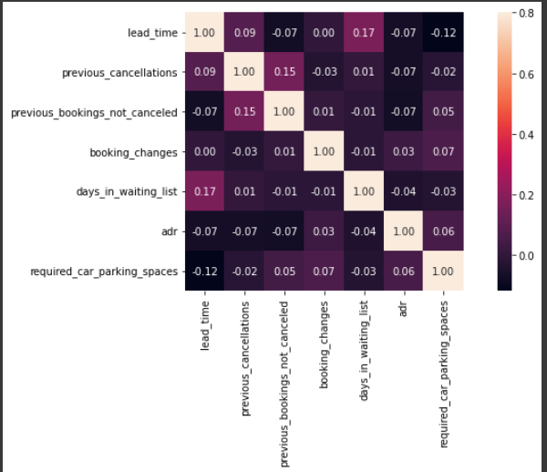
correlation matrix
1) Total stay length and lead time have slight correlation. This may means that for longer hotel stays people generally plan little before the the actual arrival.
2) adr is slightly correlated with total_people, which makes sense as more no. of people means more revenue, therefore more adr.
Lets see does length of stay affects the adr.
Conclusion:-
* Lead-time and total stay is positively correlated means more is the stay of customer more will be the lead time.
* ADR(average daily rate) and total people are highly correlated. That means more the people more will be the adr. High adr means high revenue.

Slide 10
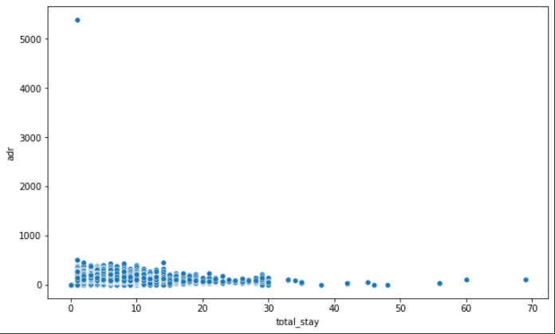
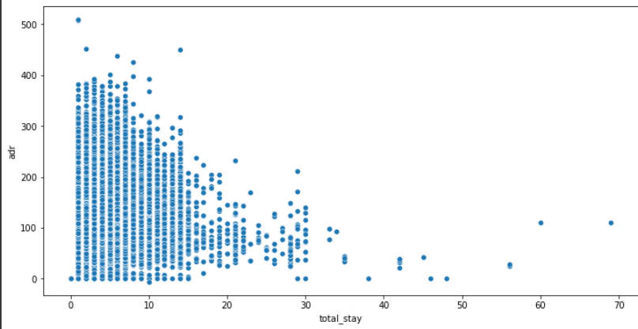
Exploratory Data Analysis(EDA)

Slide 11
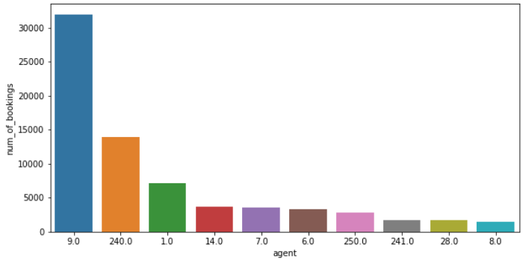
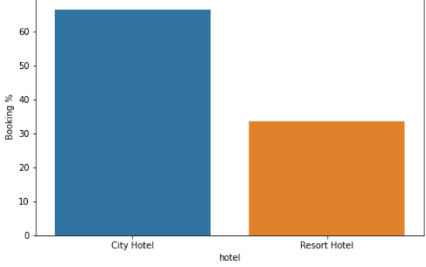
Exploratory Data Analysis(EDA)
Conclusion:-
The graph shows agent no. 9 has maximum number of bookings and Agent number 8 have lowest number of bookings

Slide 12
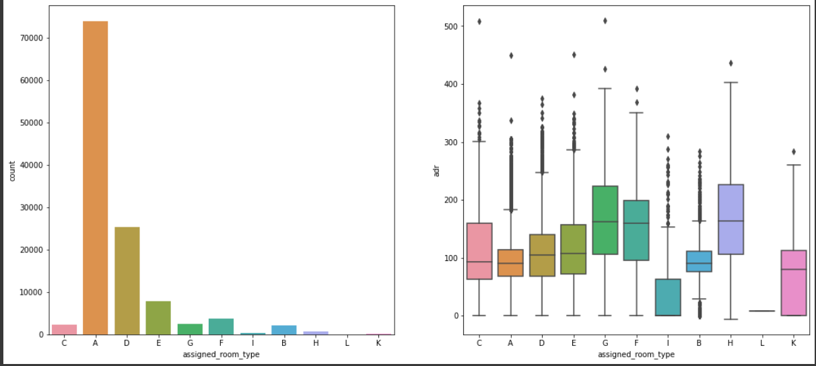

Exploratory Data Analysis(EDA)

Slide 13
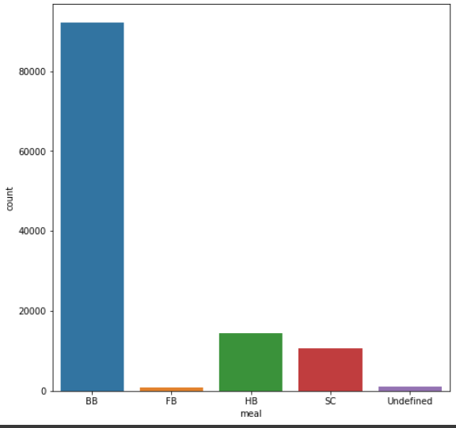
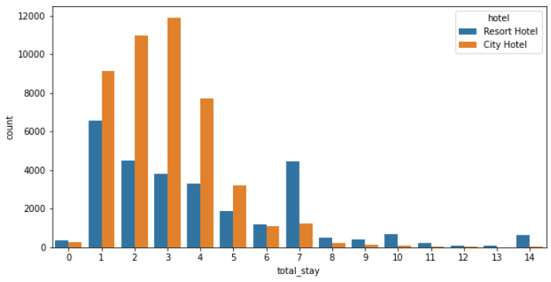
Exploratory Data Analysis(EDA)
BB(bed & Beakfast ) is the most preffered type of meal by the guests.
Full board (FB) is least preffered.
HB and SC are equally preferred.
Most of the people stay In city hotel.

Slide 14
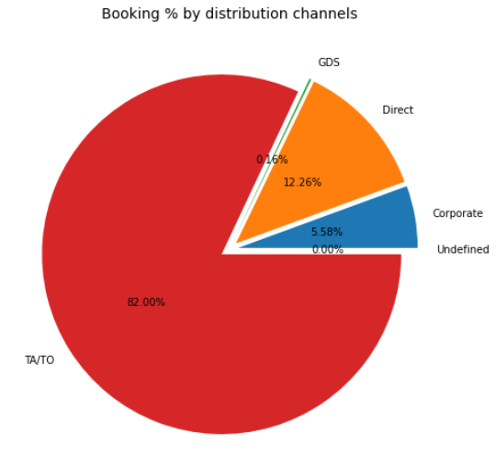
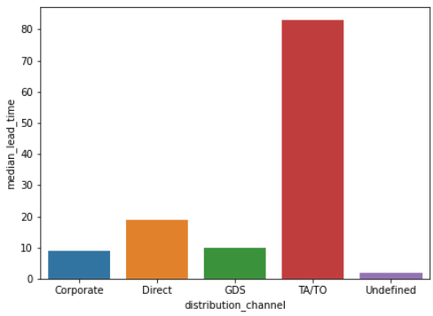
Exploratory Data Analysis(EDA)

Slide 15
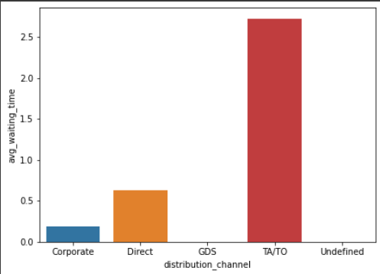
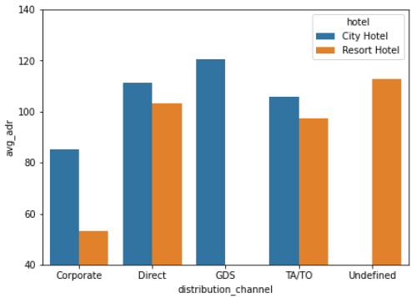
Exploratory Data Analysis(EDA)
GDS channel brings higher revenue generating deals for City hotel, in contrast to that most bookings come via TA/TO. City Hotel can work to increase outreach on GDS channels to get more higher revenue generating deals.

Slide 16
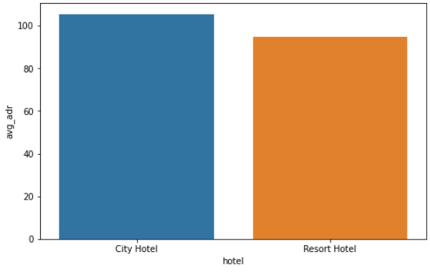
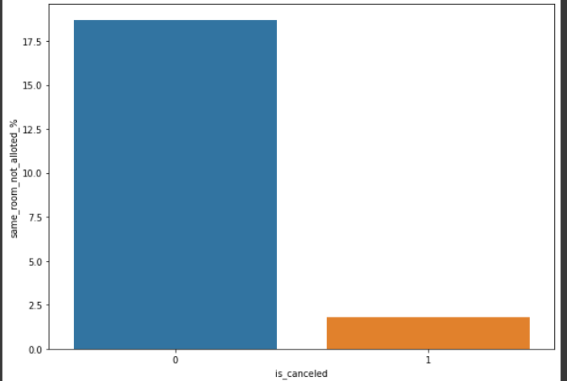
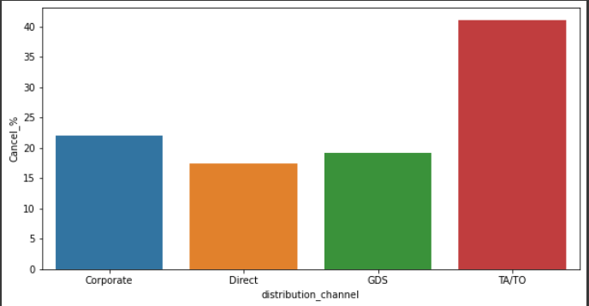
Exploratory Data Analysis(EDA)
Conclusion:-
Only 2 % of same room allowed.
City hotel has maximum ade than resort Hotel
TA/TO has max no. of cancellation percentage.

Slide 17
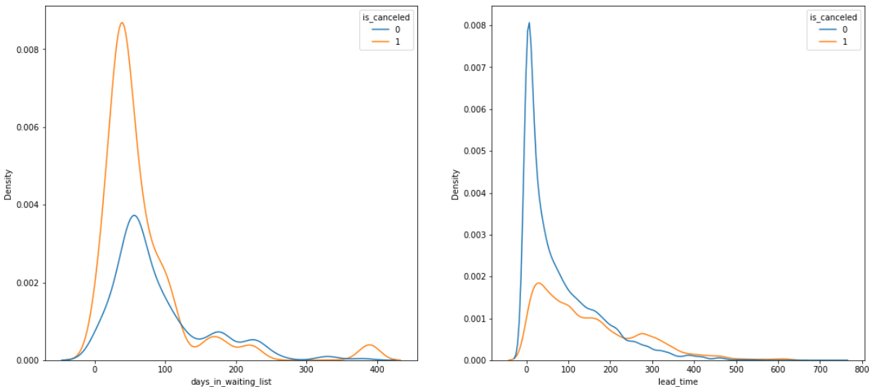
Exploratory Data Analysis(EDA)
Conclusion:-
We see that most of the bookings that are cancelled have waiting period of less 150 days but also most of bookings that are not cancelled also have waiting period less than 150 days. Hence this shows that waiting period has no effect on cancellation of bookings. Also, lead time has no affect on cancellation of bookings, as both curves of cancelation and not cncelation are similar for lead time too.

Slide 18
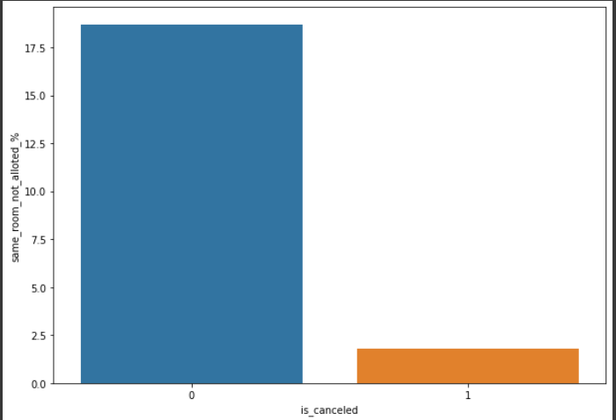
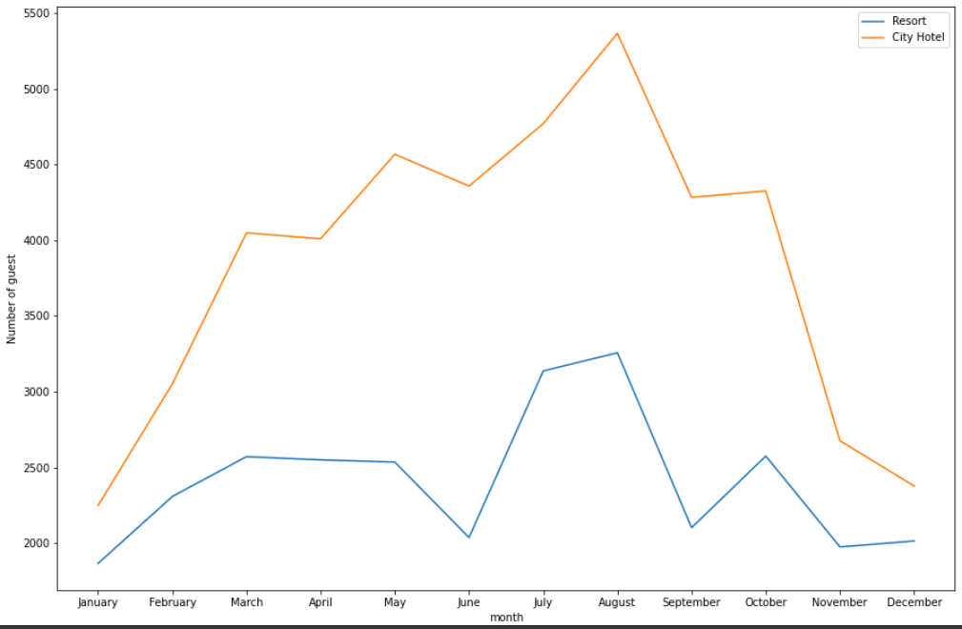
Exploratory Data Analysis(EDA)
We see that not getting same room as demanded is not the case of cancellation of rooms. A significant percentage of bookings are not cancelled even after getting different room as demanded.
Most number of guest comes in month of August.

Slide 19
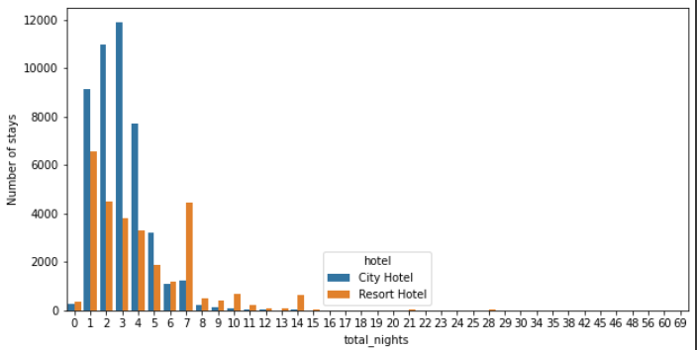
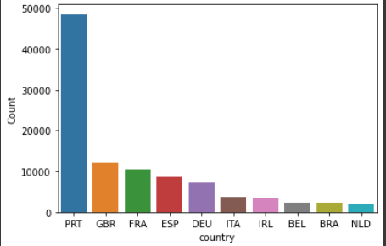
Exploratory Data Analysis(EDA)
Most people prefer to stay at the hotels of <=5 days
Country PRT has highest count value.

Slide 20
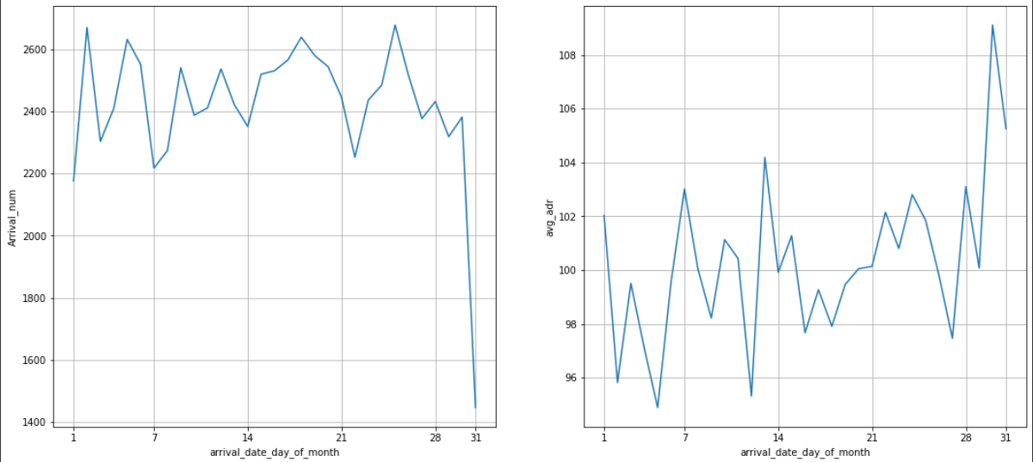
Exploratory Data Analysis(EDA)
We can see that graph Arrival_num has small peaks at regular interval of days. This can be due to increase in arrival weekend.\ \ Also the avg adr tends to go up as month ends. Therefore charge more at the end of month.

Slide 21


